Slide 1







Our Esteemed Partners
National Partners
Executive Partners

Slide 2
Why is individual registration?
Direct Competition Access – Participate in India’s largest maths competition
Self-Learning & Confidence – Improves independent learning and problem-solving skills
Equal Participation Opportunity – Compete at district, state, and national levels
Better Logical Thinking – Enhances focus, speed, and analytical ability
Recognition & Rewards – Earn certificates, rankings, and awards
Healthy Competitive Spirit – Builds discipline and academic motivation
Anytime Practice Access – Learn through the I am Samarth web/mobile app
Future-Ready Digital Learning – Supports innovation-based and digital education
Performance Tracking – Monitor progress and improvement in real time
Secure Student Data – Protected under Digital Personal Data Protection (DPDP) Act 2023 compliance

Slide 3
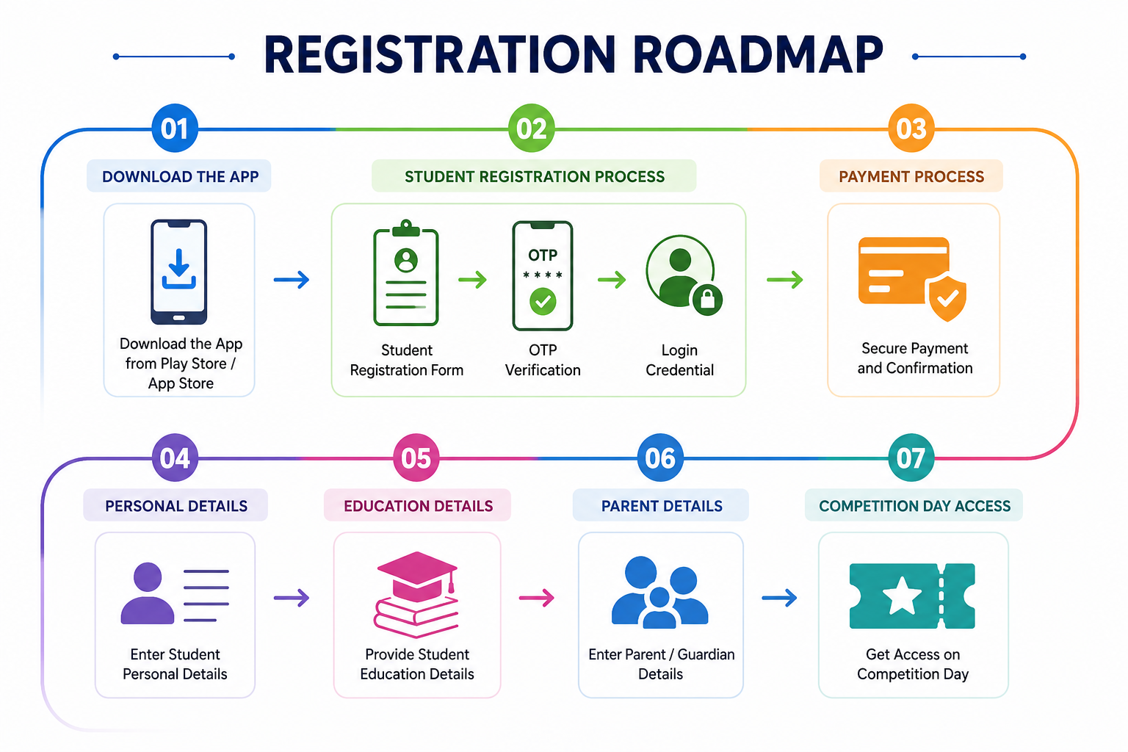

Slide 4
Individual Student Registration – Guide
Importance of Registration Process
The Individual Student Registration process allows students to officially participate in Maths Genius 2026 through the I am Samarth web/mobile app with secure access to learning modules and participation tracking.
Benefits for Students
A student solves 120 questions on their phone/laptop in 4 minutes.
They get unlimited attempts - if they fail, they try again. No punishment, no elimination.
They must achieve 90% accuracy in 7 consecutive attempts to advance to the next level.
The app uses an Icon-Based Interface (Play, Pause, Next) - even students with basic literacy can navigate it without knowing English.
The entire system runs on mobile or laptop. No paper, no teacher involvement, no logistics.
Outcome: This guide provides the complete step-by-step process for individual student registration, account verification, participation confirmation, and access to the Maths Genius 2026 learning through the I am Samarth web/mobile app.

Slide 5

Contents
Download the App
Student Registration Process
  Student Registration Form
  OTP Verification
  Login Credential
Payment Process
  Personal Details
  Education Details
  Parent Details
  Competition Day Access
5

Slide 6
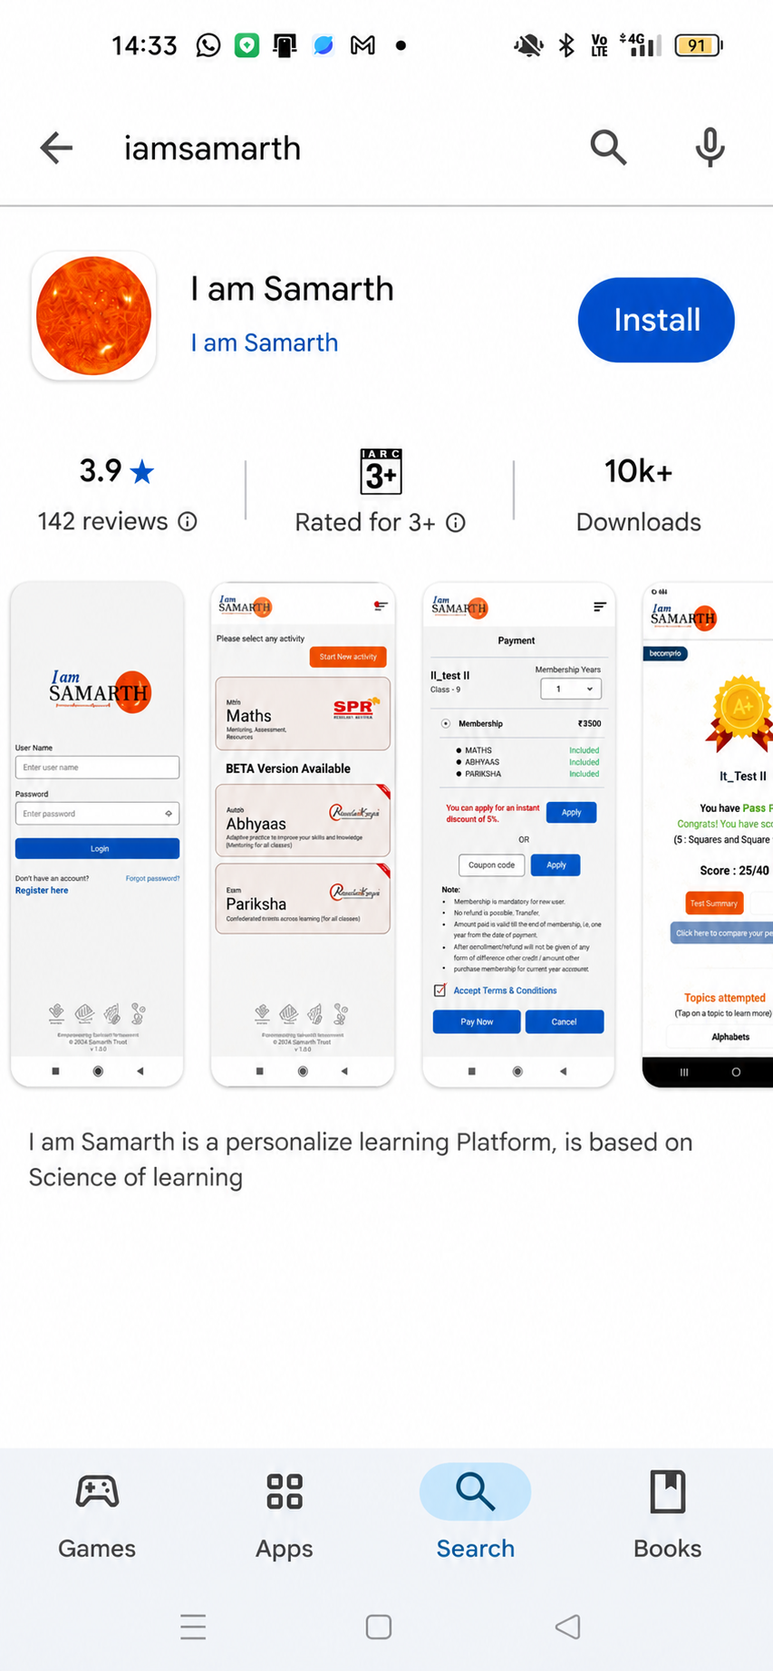


1
Download the “I am Samarth” App
1. Play Store (Android) or App Store (iPhone)
2
1
2. Install and open the application
What Happens Next?
Proceed to the login process using your registered credentials.
Img.1: Download App Screen

Slide 7
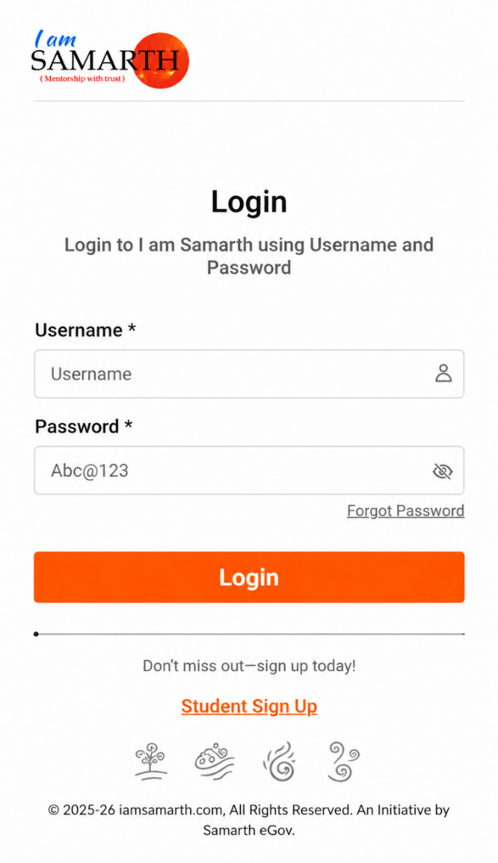
1
1.1. Student Login Process
To begin the individual student registration for Maths Genius 2026:
Note: (*) mandatory field
  Click on “Student Sign Up”
What Happens Next?
The student registration form will open, where the student must fill in the required registration details to create their account and continue the participation process.
1
Img.1.1: Student Sign Up Screen

Slide 8
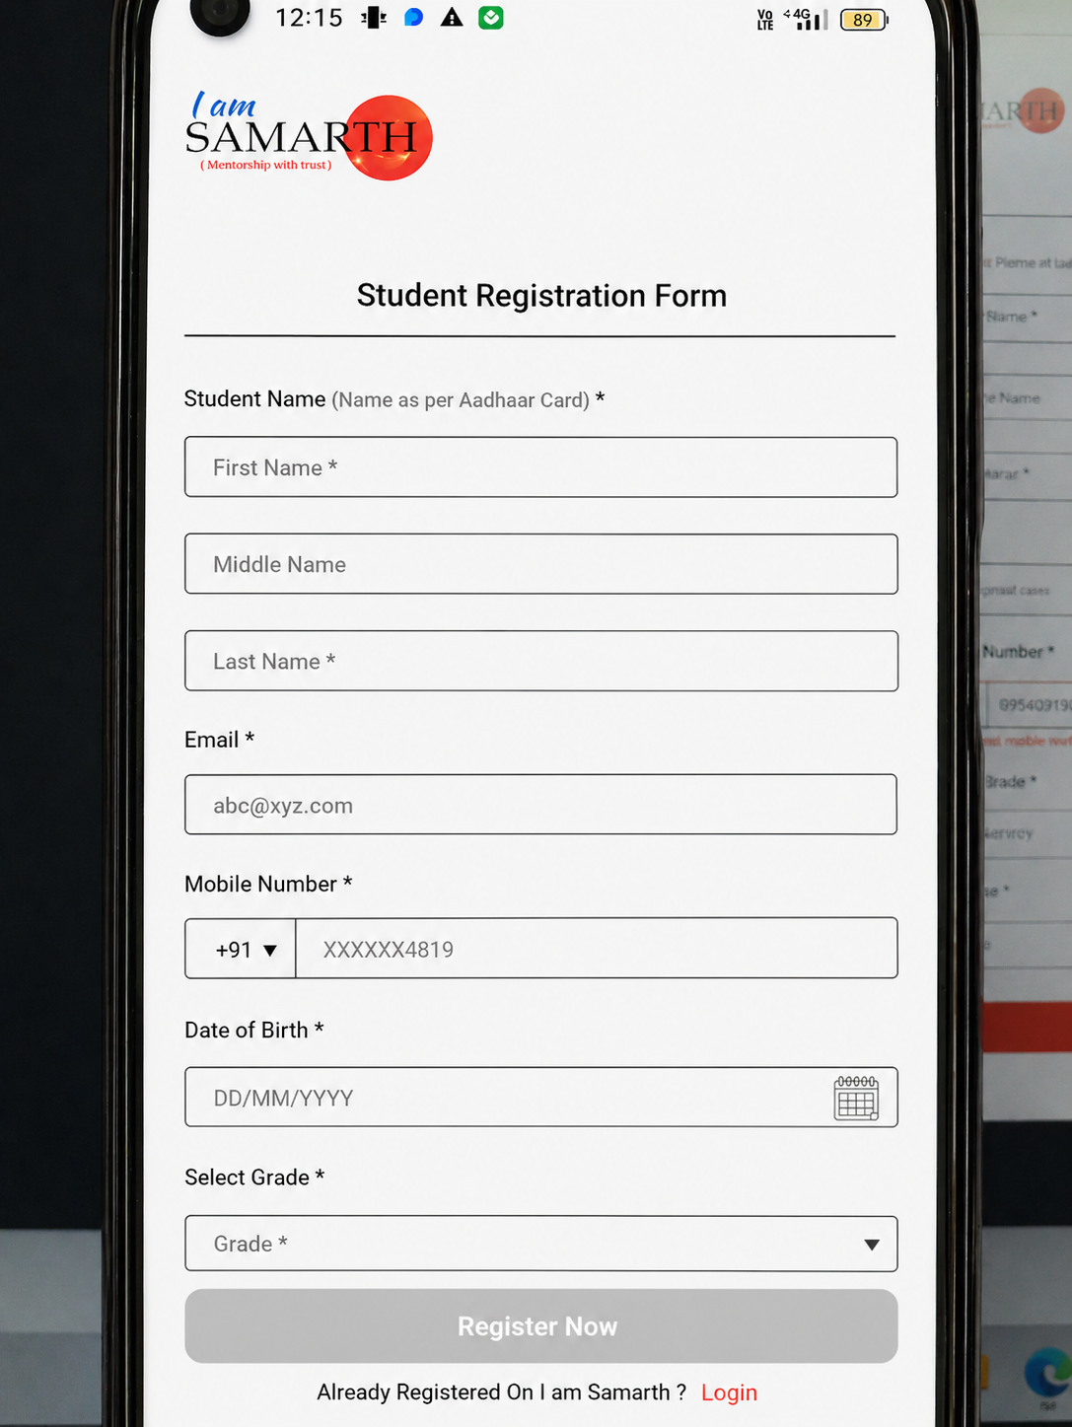
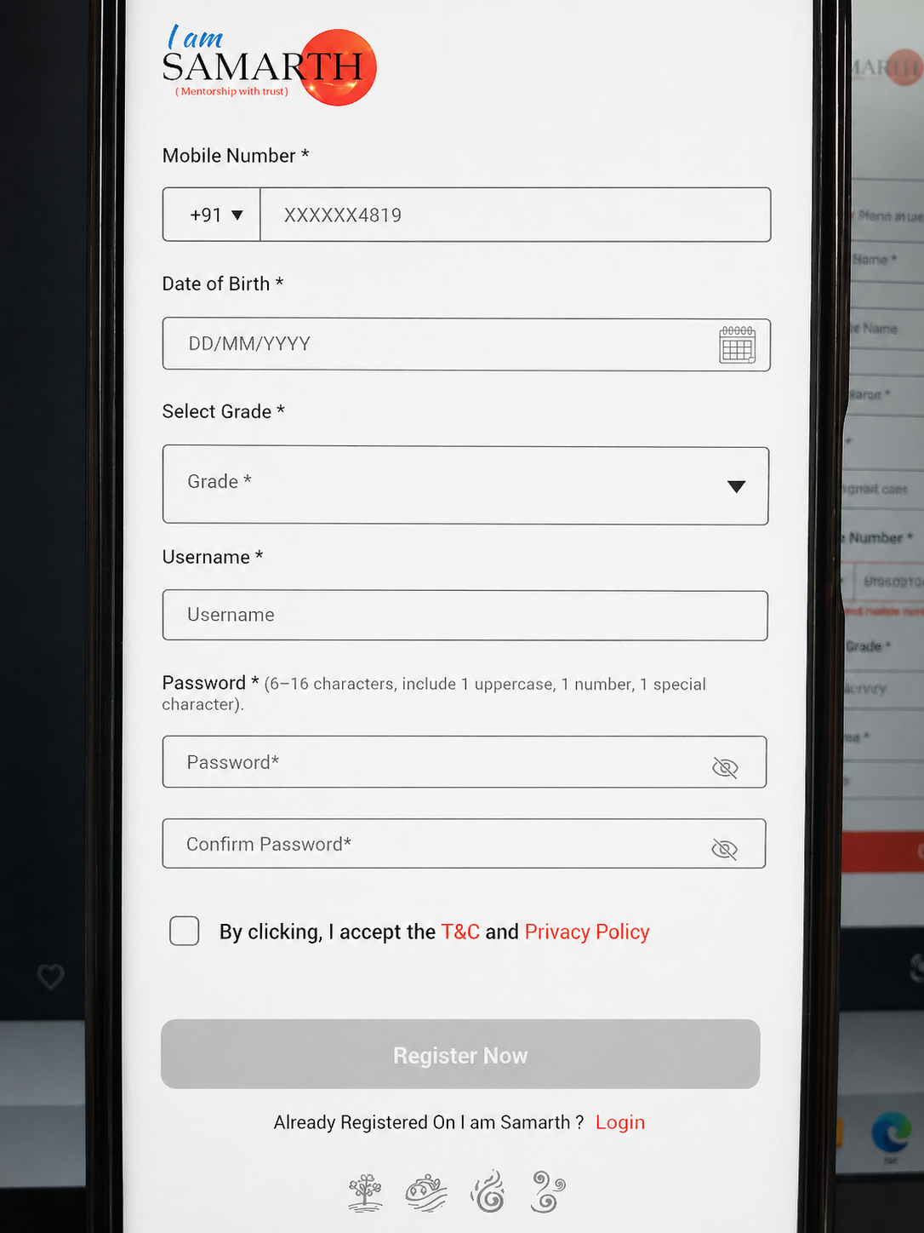
2
Student Registration Form
Fill in the following details:
Note: (*) mandatory field
  Full name as mentioned on your Aadhaar Card (first name, middle name and last name)
  Email
  Mobile number
  Date of birth
  Select your Grade
  Username – should be 6-15 characters long & include lowercase letters, numbers & symbols such as “.”, “-”
  Password – should be strong & 6-16 characters long. It should include at least 1 uppercase letter, 1 numbers and special character like !, @, # or $
  Confirm password
  Click on the checkbox to accept the Terms & Condition and Privacy Policy
  Click on the “Register Now”
1
6
2
3
7
4
12
9
5
10
What Happens Next?
“Register Now” submission moves the user to OTP Verification
Img.2.: Student Registration Screen

Slide 9
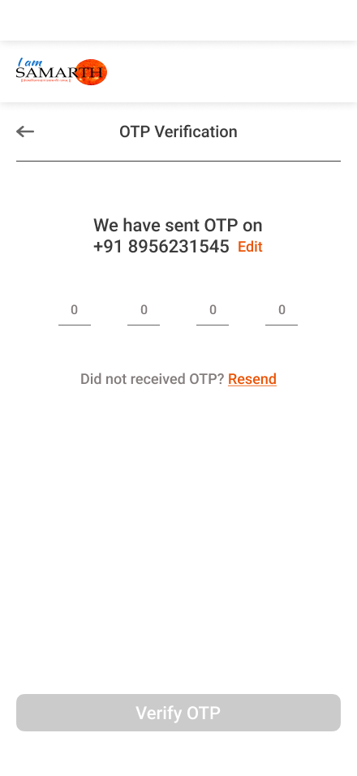
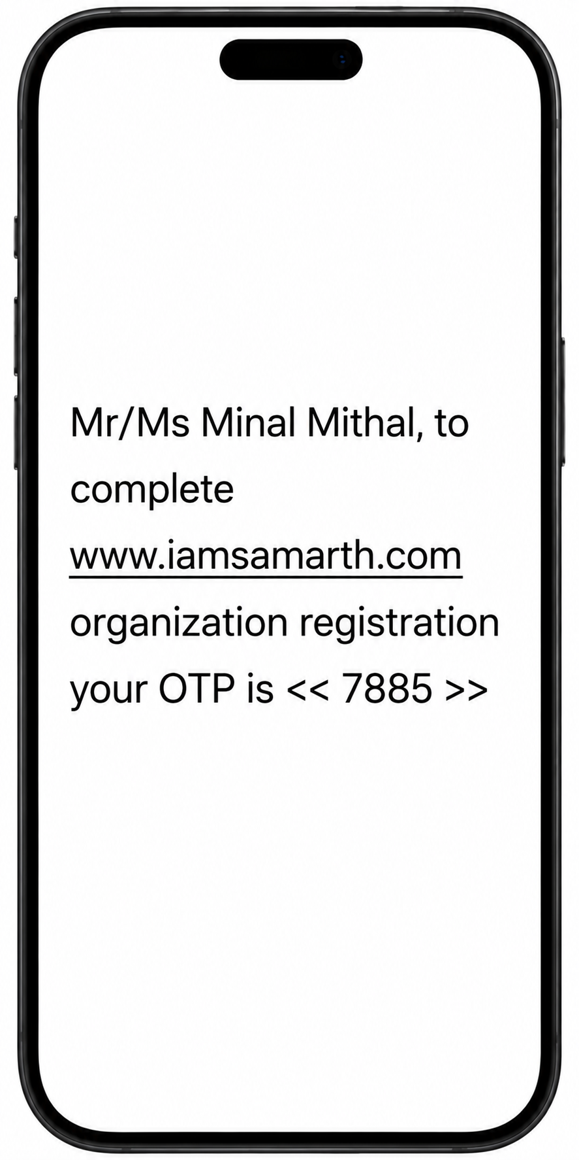
2
2.1. OTP Verification Process
  Enter the OTP received on your registered Mobile Number
  Click the “Verify OTP”
  If you enter the wrong mobile number, click Edit, re-enter the correct number, click Get OTP, enter the new OTP and click verify OTP again
Tanishka
1
student registration
What Happens Next?
Your sign-up process is complete, and your username and password will be shared with your registered email and mobile number for reference.
2
Img.2.1: OTP Verification Screen

Slide 10

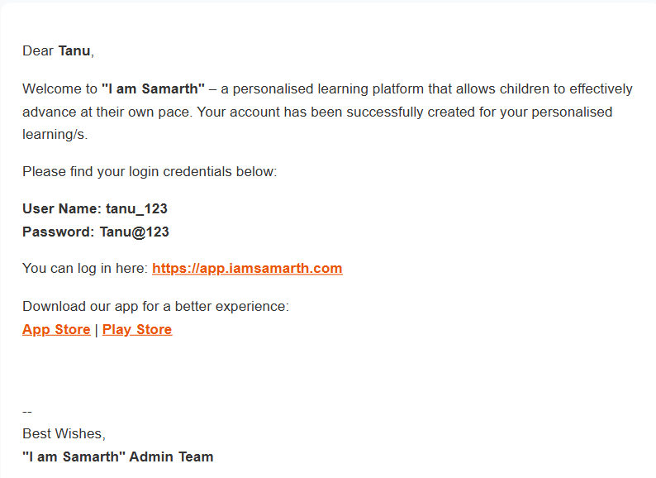
2
2.2. Login Credential
Check your email inbox or spam folder to find your username and password, to fill in the login screen:
  Enter Username & Password
  Click Login
1
2
What Happens Next?
After successful login, proceed to the payment process.
Img.2.2: Login Screen

Slide 11
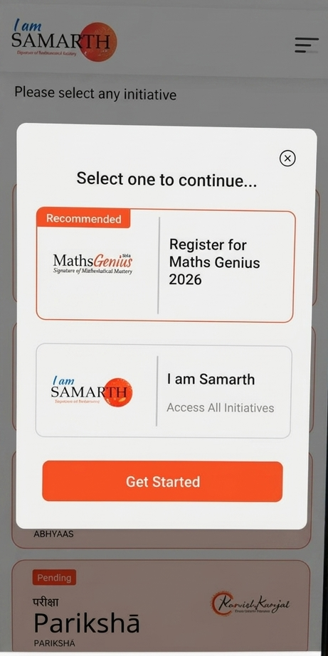
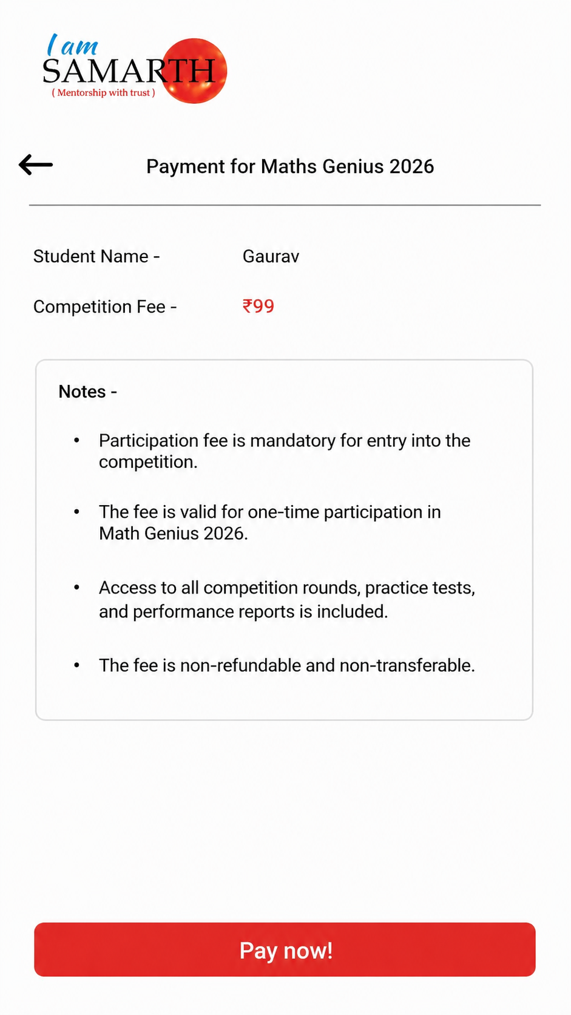
3
Payment Process
Click on Register for Maths Genius 2026 Card
Click on Get Started
Click on Pay Now on the next screen
1
2
3
Img.3: Payment for Maths Genius 2026 Screen

Slide 12
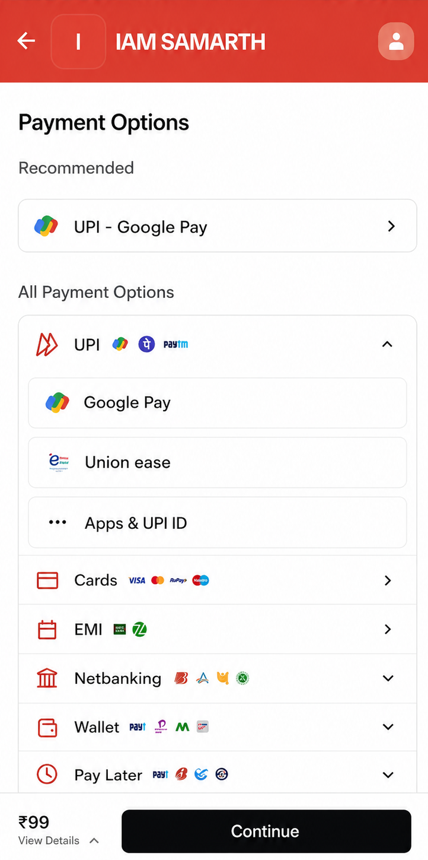
3
3.1. Payment Process
    To complete the participation payment for the competition
    Complete the payment of ₹99 using preferred payment method
    Wait for payment confirmation
What Happens Next?
After successful payment, process to fill in personal details, educational details and parent details to complete your registration for the competition.
Img.3.1: Payment Option Screen

Slide 13
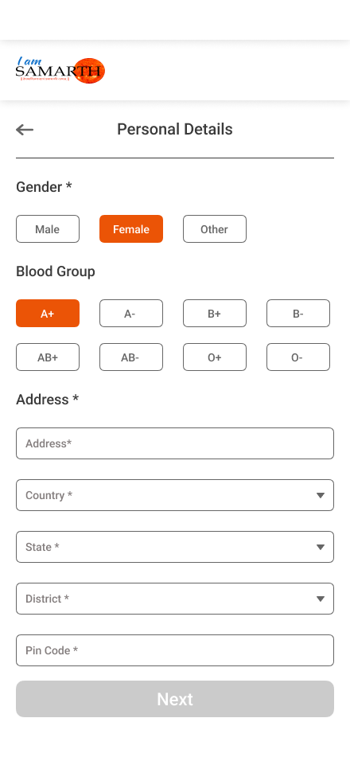
4
Personal Details
Note: (*) mandatory field
Select Gender
Select Blood Group
Enter Address details
Select Country, State and District
Enter Pin Code
Click on “Next”
1
2
3
What Happens Next?
You will move to the educational details section
4
5
6
Img.4: Personal Details Screen

Slide 14
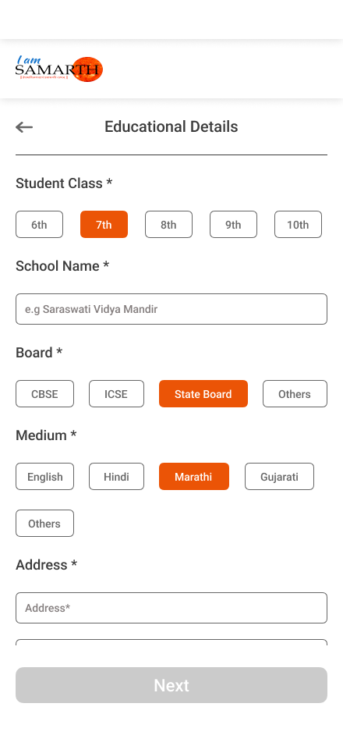
5
Educational Details
Note: (*) mandatory field
Select your class
Enter the full School Name
Choose the Board
Choose the Medium
Enter the School Address, Select the Country, State, District and PIN Code
Click on Next
1
2
3
4
What Happens Next?
You will move to the parent details section
5
6
Img.5: Educational Details Screen

Slide 15
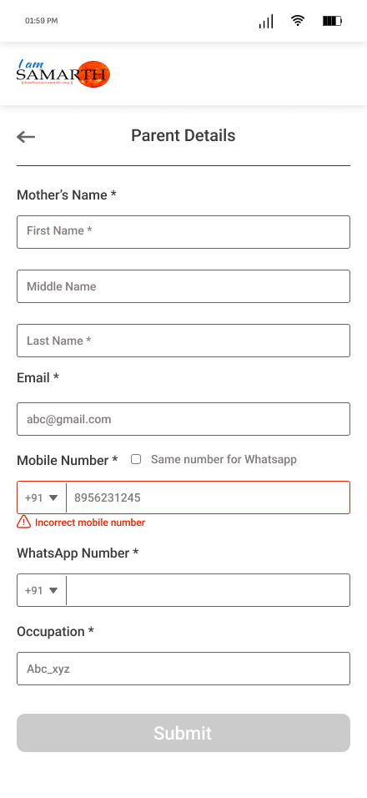
6
Parent Details
Note: (*) mandatory field
Enter Mother’s Name such as First Name, Middle Name and Last Name
Enter Mother’s Email
Enter Mother’s Mobile Number
Enter the Mother’s WhatsApp Number
Enter the Mother’s Occupation
Similarly, enter father’s details
Click the “Submit”
1
2
3
Your registration process for the Maths Genius 2026 competition is completed successfully.
4
5
6
Img.6: Parent Details Screen

Slide 16
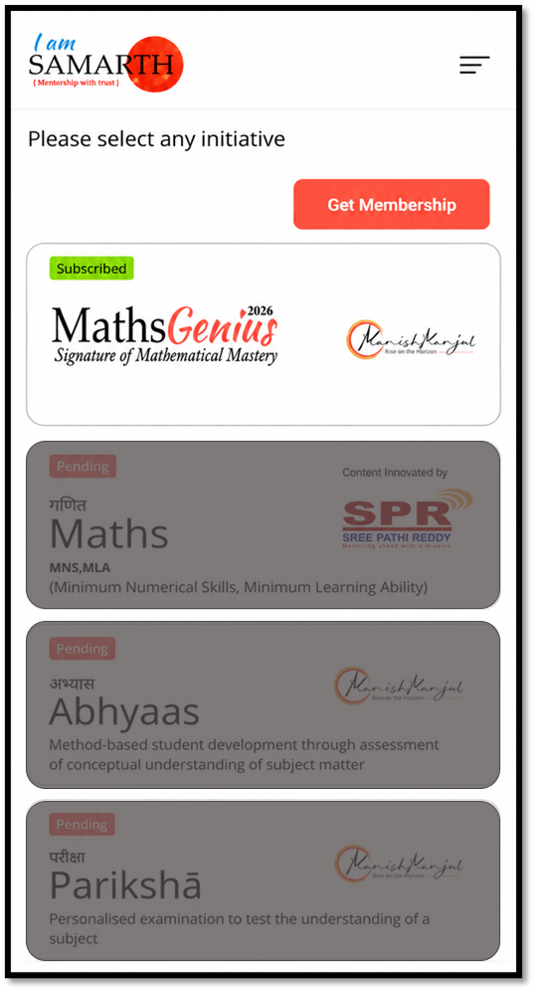
7
Competition Day Access
To access the Maths Genius 2026 competition on the scheduled date:
Login in to the “I am Samarth web/mobile app using your username and password
Click on the “Maths Genius 2026” card
Rest of the cards (Maths, Abhyaas, Pariksha) are disabled till competition finishes
You can begin participating in the competition successfully.
Img.7: Initiative Screen

